Slide 1

Matching Identical and Similar Images Using a Novel Approach
Brian R Deering
Cyber Crime Analyst
Agile Defense
Reston, VA 20191
805.889.1676
brian.deering@agile-defense.com
pndfam05@gmail.com (preferred)
Presented at PFIC 2016 September 8 and 9, 2016
Notes:
Think of this more as a concept than a product and one that is still being developed.
As it is right now, it will match identical images even though the file content may not be the same. It will match images even though they might be rotated, flipped or both.
It will match across all three major internet image format s (*.jpg, *.bmp, *.png)
I envision this process inserted into a processing stream somewhere after hash matching. Hash matching will be the most reliable.
This process will catch other identical images when file content has changed. Such as would be the case when metadata is added or modified or if the image is rotated.

Slide 2
Objectives
Introduce you to an image matching concept that can be folded into existing processes
Match known images to unknown images
Even though they generate different hash values
Match known images to similar images
Group similar images
Dedupe images on a file system
Notes:
Think of this as a proof of concept. It is not a finished product and it’s not intended to be a complete solution.
The process (which still needs a good name) compares the colors of the pixels as seen on screen rather than file content. Therefore, additions to or changes of metadata, both of which cause hash changes.
The code is written and executes in R. For those unfamiliar, R is an incredibly powerful, open source statistics package. The most common users of R are academicians and students.
R is not made to process images. Consequently, this code runs very slowly. My code relies heavily on an R package named “readbitmap” that does the heavy lifting of determining pixel colors.
And to a much lesser degree an R package named “broman” that is used to interpret hexadecimal.

Slide 3
Why?
To more quickly locate images of interest when hash matching fails

Slide 4
A Novel Approach to Image Matching
What is an image?
Image on disk v. image on-screen
Counting colors
The World is not a colorful place
Statistical Correlation
Statistics is your friend
Across Image Types
Regardless of Orientation
Robust Against Resizing
Immune to Metadata Changes
Notes:
The three main concepts that must be understood are:
This process works on the colors in the image, what is seen onscreen, and not the content of the files
Most images use a very small part of the available color palette. An image that uses more than 20% of the color palette is unlikely to occur in the wild.
Even a fairly large image, say 2,000 x 2,000 pixels, could contain only 4 million different colors. About 25% of the palette
Statistical measures.
Color distribution of K₁ = U₁.
Correlation strength of color distribution of K₁ compared to U₁.
Right now, color distribution is the only discriminator.
There are others that might reduce the likelihood of false positives but I have not experimented with those.
Mean color?
Image aspect ratio
Color distribution by quadrant
Proximity – The best estimator of any pixel’s color is the color of the pixels it abuts.

Slide 5
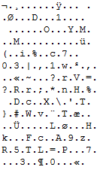
Image on Disk v. Image On-screen
Clear your mind and think about this one!

Slide 6

What’s in an Image?
Pixels
Defined places with exact dimensions
One pixel, one color
Each pixel must be one of 2^²⁴ (16,777,216) different possible colors
256 possible colors in each RGB plane (256^³ = 16,777,216)
Minimum size image with all 2^24 colors is 4096 x 4096 pixels
Few images are that large
The world is not a colorful place
Notes:
Explanation of how pixels can be but one color at a time.

Slide 7
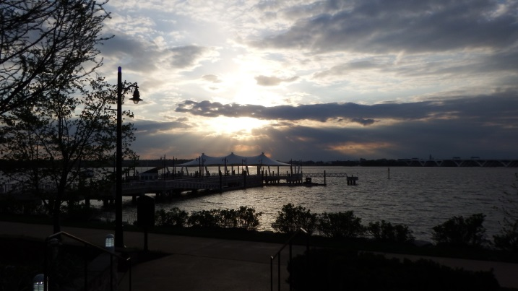

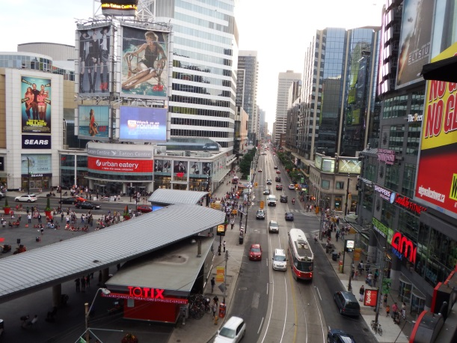
The World’s Not a Colorful Place
4608 x 2592
Unique colors = 80,005
< 1.0% of the palette
Max colors possible = 71%
1000 x 903
Unique colors = 230,549
1.37% of the palette
Max colors possible = 5%
2048 x 1536
Unique colors = 252,890
1.5% of the palette
Max colors possible = 19%
Notes:
The world is not a colorful place. Even when it appears to be (as in the bottom image) it still uses a very small part of the palette.

Slide 8
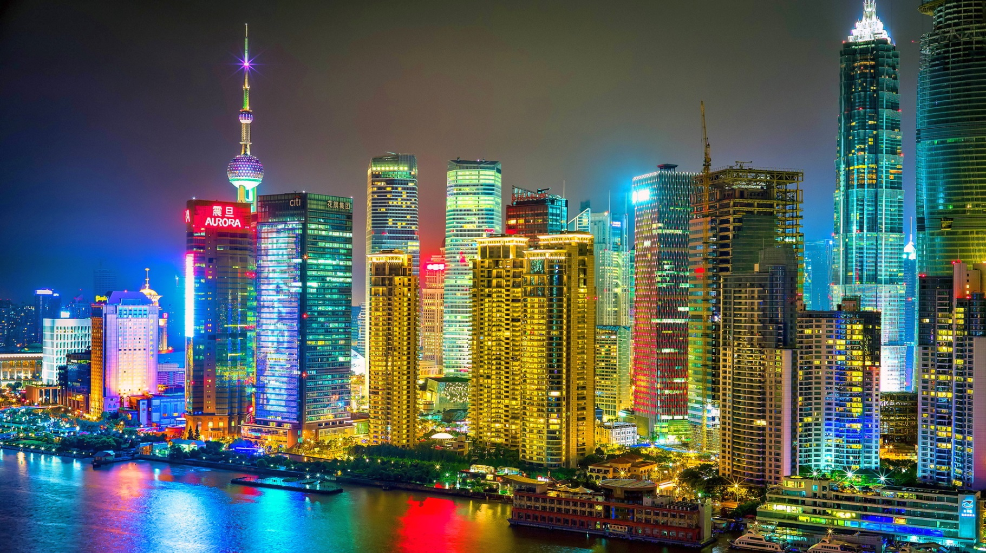
Even Colorful Places Aren’t That Colorful!
1920 x 1200
Unique colors = 805,440
4.78% of the palette
Keep This in Mind: The World is Not a Colorful Place!
Max colors possible = 19%

Slide 9
Zoom In – and in – and in….
For illustrative purposes only!
1 | 6 | 1 | 7 | 4 | 6
5 | 6 | 4 | 7 | 1 | 6
4 | 1 | 5 | 2 | 2 | 4
3 | 3 | 1 | 7 | 6 | 5
2 | 6 | 6 | 8 | 4 | 1
6 | 2 | 2 | 8 | 1 | 4
Keep This in Mind: It’s the Pixels That Matter!
Notes:
Orientation to image pixels and that each has a color number associated with it.

Slide 10
Statistics Is Your Friend!
sta◦tis◦tics – noun – the practice or science of collecting and analyzing numerical data in large quantities, especially for the purpose of inferring proportions in a whole from those in a representative sample.
Often used to express observations and answer questions.
Mozzarella consumption has been increasing for the last decade.
I wonder if mozzarella consumption is related to the number of Civil Engineering PhD Degrees awarded?
Notes:
Introduces statistics as being something more than a simple mean or median.
Question demonstrates kinds of things statistics can tell us. The question is actually answered later in this show.

Slide 11
Statistical Correlation (most often simply “r”)
Correlation is a statistical technique used to measure and describe the STRENGTH and DIRECTION of the relationship between two variables.
If we have two variables, to what extent can we estimate the value of one variable given the value of the other variable?
r ranges from -1 to 1
-1
-0.9
-0.8
-0.7
-0.6
-0.5
-0.4
-0.3
-0.2
-0.1
-0.0
0.1
0.2
0.3
0.4
0.5
0.6
0.7
0.8
0.9
1

Slide 12
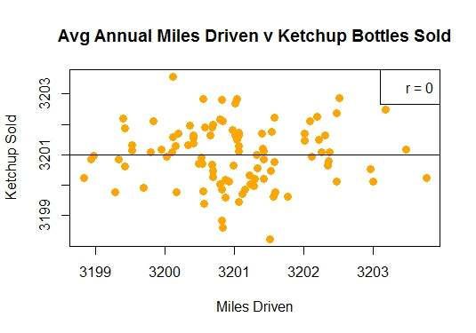
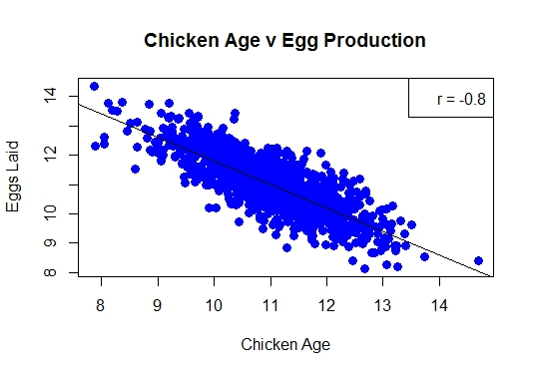
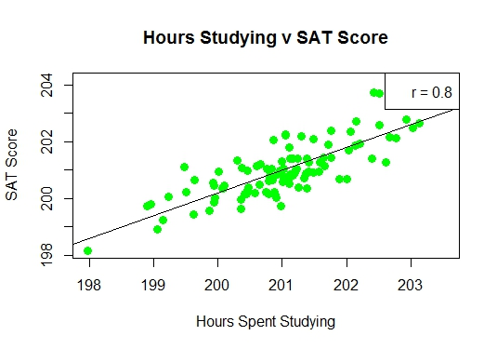
Statistical Correlation
Negative
Positive
r
-1
-0.9
-0.8
-0.7
-0.6
-0.5
-0.4
-0.3
-0.2
-0.1
0.0
0.1
0.2
0.3
0.4
0.5
0.6
0.7
0.8
0.9
1
No Correlation
Negative Correlation
Positive Correlation
Don’t quote me on any of these correlations. The data are entirely fabricated!
Notes:
Examples of statistical correlation.
We’re only concerned with positive correlations and most often we’ll be in the 0.85 to 1 range.

Slide 13
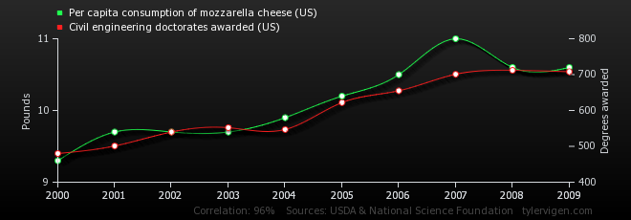
Correlation ≠ Causation!
In the U.S, is there a correlation between the annual consumption of mozzarella cheese and the number of Civil Engineering doctorates awarded?
Eat Your Way to a PhD!
Correlation: 0.958648 ~ There is an extremely high correlation between mozzarella consumption and the issuance of Civil Engineering doctorates.
Notes:
Answers the question of mozzarella cheese consumption and earning PhD.

Slide 14
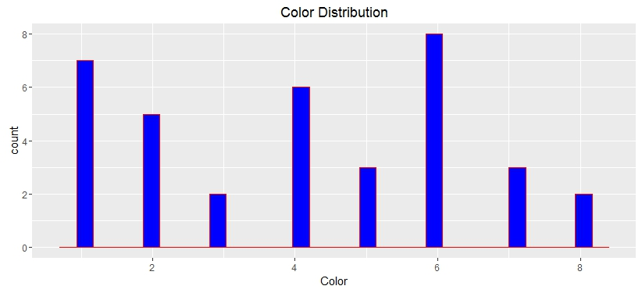
Color Distribution of My Known Image
1 | 6 | 1 | 7 | 4 | 6
5 | 6 | 4 | 7 | 1 | 6
4 | 1 | 5 | 2 | 2 | 4
3 | 3 | 1 | 7 | 6 | 5
2 | 6 | 6 | 8 | 4 | 1
6 | 2 | 2 | 8 | 1 | 4
7 | 5 | 2 | 6 | 3 | 8 | 3 | 2
1 | 2 | 3 | 4 | 5 | 6 | 7 | 8
Notes:
This represents is K₁.
The process determines the color of each pixel and stores all of the values in a vector, the length of which equals the number of pixels.
E.g., an image that measures 2,000 x 2,000 pixels will have a total of 4,000,000 pixels. Each pixel has a color. In the vector, each pixel’s color will be one element. Think of it as a single line of text with 4,000,000 values in it.
A critical step to prepare the data for correlation is to bin the color vector for each image. You can’t correlate two vectors of unequal length.
I use bins of 4,096 pixels each which means there will be 4,096 color bins. The number of bins can be changed but must be some power of 2.
I have done some limited testing and small changes to the number of bins has minimal overall effect.
The histogram is provided for graphic representation. Histograms are not created or required for this process to work.

Slide 15
Color Distribution of an Unknown Image
1 | 6 | 1 | 7 | 4 | 6
5 | 6 | 4 | 7 | 1 | 6
4 | 1 | 5 | 2 | 2 | 4
3 | 3 | 1 | 7 | 6 | 5
2 | 6 | 6 | 8 | 4 | 1
6 | 2 | 2 | 8 | 1 | 4
7 | 5 | 2 | 6 | 3 | 8 | 3 | 2
1 | 2 | 3 | 4 | 5 | 6 | 7 | 8
Notes:
This is U₁.
Similar binning of colors for an image from the unknown file system.
This image is identical to K₁. In a real scenario, hash values would be the best way to match these images unless the file content has changed or the file has been rotated or flipped.

Slide 16

More Comparisons
Notes:
A graphical representation of color distribution color profiles.
Even though each image is the same image, each image is differently formatted and would generate different hash values.
The color distribution profiles are, however, identical.
(This is a simplified, illustrative example of color binning. The colors used in the matrix and table are fabricated and the number of bins too small to be effective.)

Slide 17

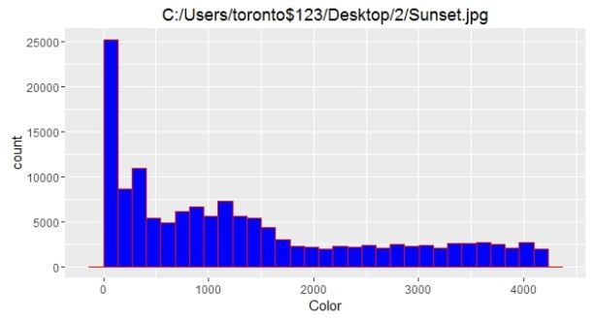
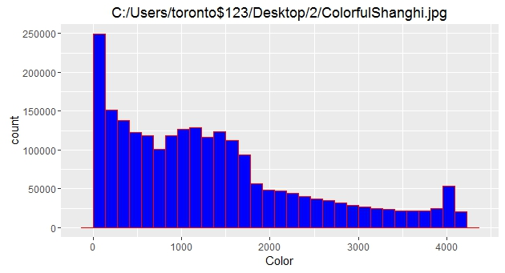
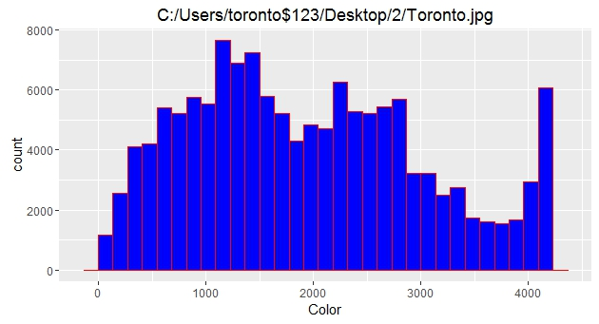
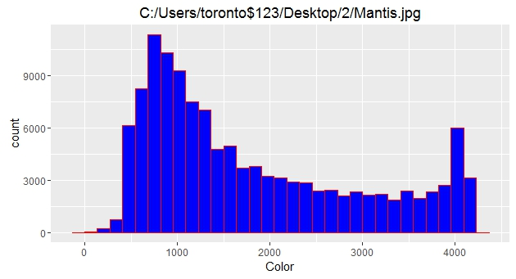







Color Distribution Profiles
Notes:
Indeed, looking at the color distribution of different images, each is different.
These histograms are the actual 4096 binned color distributions further compress into 30 bars.

Slide 18
Correlating Identical Images
1 | 6 | 1 | 7 | 4 | 6
5 | 6 | 4 | 7 | 1 | 6
4 | 1 | 5 | 2 | 2 | 4
3 | 3 | 1 | 7 | 6 | 5
2 | 6 | 6 | 8 | 4 | 1
6 | 2 | 2 | 8 | 1 | 4
1 | 6 | 1 | 7 | 4 | 6
5 | 6 | 4 | 7 | 1 | 6
4 | 1 | 5 | 2 | 2 | 4
3 | 3 | 1 | 7 | 6 | 5
2 | 6 | 6 | 8 | 4 | 1
6 | 2 | 2 | 8 | 1 | 4
7 | 5 | 2 | 6 | 3 | 8 | 3 | 2
1 | 2 | 3 | 4 | 5 | 6 | 7 | 8
7 | 5 | 2 | 6 | 3 | 8 | 3 | 2
1 | 2 | 3 | 4 | 5 | 6 | 7 | 8
Correlation (r) = 1.0
Notes:
K₁ is the image on the left and the upper table.
U₁ is the image on the right and its table is the lower.
These are the same distributions. At this point in the process, if K₁ color distribution table = U₁ color distribution, there is a match and processing can move to the next file without completing the processor intensive correlation step.
In any event, if the variables being correlated are equal then correlation between the two will always be 1. The extra step of correlation would would not provide us with any additional useful information.

Slide 19
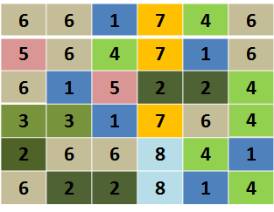
Correlating Similar Images
K₁
U₁
1 | 6 | 1 | 7 | 4 | 6
5 | 6 | 4 | 7 | 1 | 6
4 | 1 | 5 | 2 | 2 | 4
3 | 3 | 1 | 7 | 6 | 5
2 | 6 | 6 | 8 | 4 | 1
6 | 2 | 2 | 8 | 1 | 4
7 | 5 | 2 | 6 | 3 | 8 | 3 | 2
1 | 2 | 3 | 4 | 5 | 6 | 7 | 8
K₁
6 | 5 | 2 | 6 | 2 | 10 | 3 | 2
1 | 2 | 3 | 4 | 5 | 6 | 7 | 8
U₁
Correlation (r) = 0.95
Notes:
Two different but similar images.
The color matrix has been rearranged. There are more of some colors and fewer of others.
In the tabular view, you can more easily see that the color distribution profiles are not equal. Therefore, K₁ ≠ U₁ and the additional step of correlation is warranted.
The correlation between these two tables is 0.953821. It’s within our comfortable range and the additional step of viewing the two files would be appropriate.

Slide 20
Remember “It’s the Pixels?”
All sorts of matches are possible
JPEG
JPEG
BMP
BMP
PNG*
PNG
Notes:
Since we’re comparing the color of the pixels and not file content, images will match across the three most common image types.
PNG is an odd duck, in that an image created as a .png and then changed to .jpg or .bmp does not retain the pixel distribution. A comparison of an originally created as a .png that has been converted to .jpg or .bmp is not even close. I’m uncertain why. Perhaps there’s a means to check .png files to determine if they’re consistent with an original .png format and then mathematically convert the color distribution profile to an equivalent in .jpg or .bmp.
Images originally created as .jpg or .bmp and then saved as .png do not exhibit this problem.

Slide 21
Recap
Use statistical correlation to measure similarity of color distribution between images
As images approach identicality correlation gets closer to +1
Images use a small part of the available color palette
Which makes this work
Study the pixels
Cross format functionality
Immune to changes in the bits and bytes

Slide 22
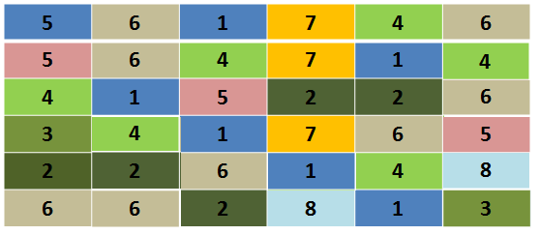
There Will Be False Positives!
Rearrange the same pixels and we have a different image
7 | 5 | 2 | 6 | 3 | 8 | 3 | 2
1 | 2 | 3 | 4 | 5 | 6 | 7 | 8
But the distribution of colors is the same.
Notes:
As is the case with hashes, there will be false positives.
It’s entirely likely that two very different and unrelated images could identical color distribution profiles. The initial test, does K₁ = U₁ would show that they are equal.
Certain factors mitigate the likelihood of false positives.

Slide 23
False Positive Mitigating Factors
It’s unlikely that two completely different images will have the same color distribution
Similar images will group around similar distributions
The world is not a colorful place
If every image used a large part of the color palette, collisions would be much more likely.
Notes:
Because images use such a small part of the available color palette, similar images will cluster around similar locations on the color palette.
Dissimilar images will not cluster in the same color palette location.

Slide 24
Take Aways
Statistics is Our Friend
Correlating color distributions across images allows us to identify identical and similar images
Identical images have identical color distribution characteristics
Similar images have similar color distribution characteristics

Slide 25
Take Aways
It’s the Pixels
We’re measuring pixel colors not bits and bytes
Matches across and between the three most common formats
Immune to image orientation change
jpg <-> jpg
jpg <-> bmp
jpg <-> png
bmp <-> bmp
bmp <-> png
png <-> png

Slide 26
Take Aways
The World is Not a Colorful Place
Makes this approach effective
The closer an image gets to using the full 2^24 color palette the greater the likelihood of a false positive

Slide 27
Use Case #1 The Problem
We have contraband images
It appears to be professionally photographed
In a studio setting
The criminal is somewhat sophisticated
To foil hash matching, he changed all JPGs to BMPs and flipped images on the horizontal axis
Since original images have been modified, hash matches did not locate any of the known images

Slide 28
Use Case #1 The Process
Record the color distribution profile of known images
Record the color distribution profile of unknowns
Compare known to unknown images
High correlation – verify
Low correlation – move on

Slide 29
How Does This Fit Into Image Matching Process?
Match Hash Values
Incredibly reliable
Match Color Distribution Table
Locates identical images even though the file content has been modified – metadata change, image orientation
Correlate images to find similar images

Slide 30
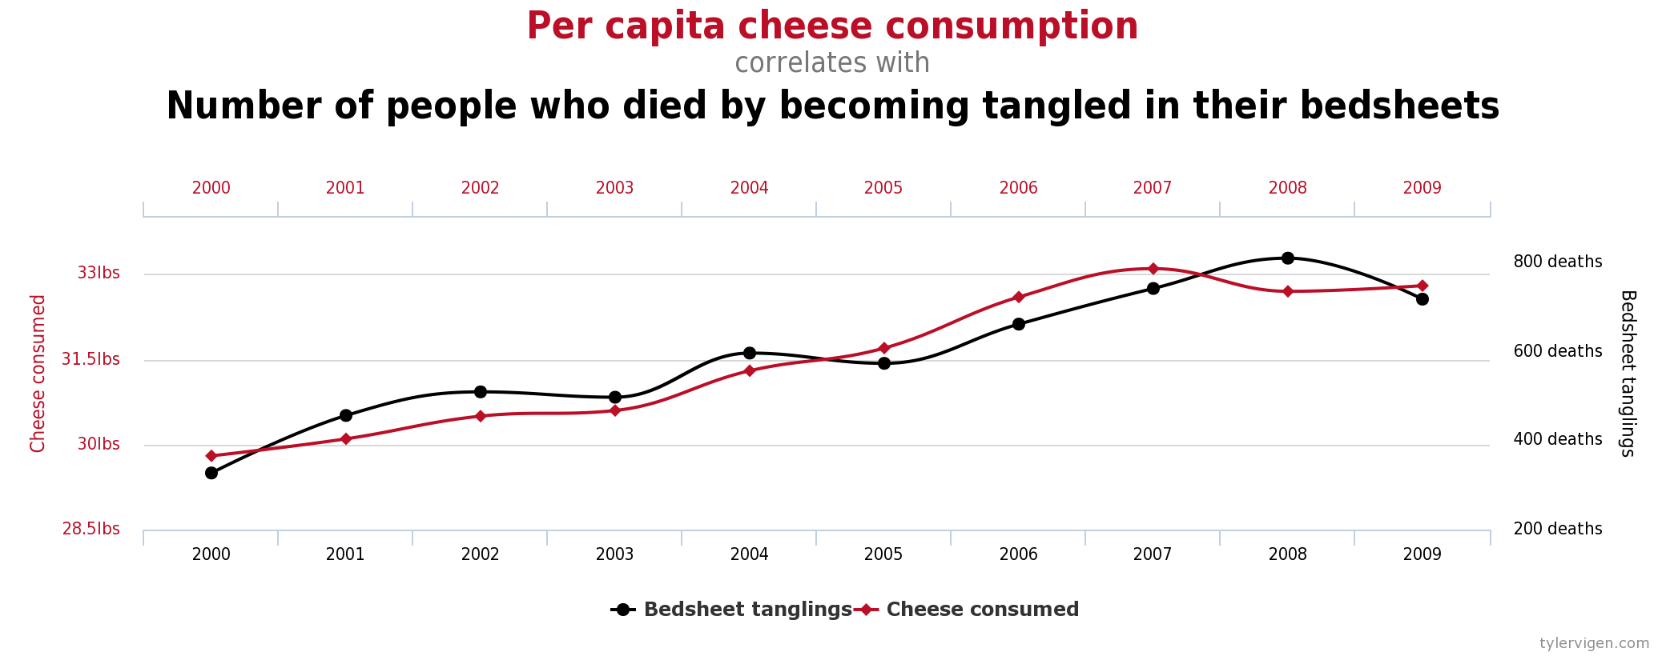
Eating Your Way to a PhD?
Be cautious of bedsheet entanglements!

Slide 31
Contact Information
Brian R Deering
Cyber Crime Analyst
Agile Defense, Inc.
11600 Sunrise Valley Dr. #320
Reston, VA 20191
805.889.1676
brian.deering@agile-defense.com
pndfam05@gmail.com
Code available on GitHub.com/pndfam05/ImageColorDistro

Slide 32
Extra Stuff

Slide 33
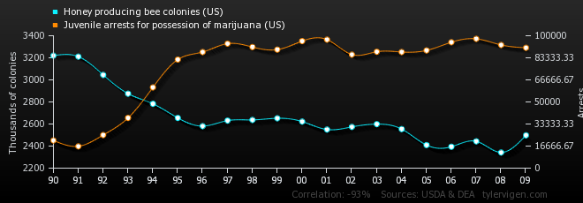
Spurious Correlations
http://www.tylervigen.com/spurious-correlations

Slide 34
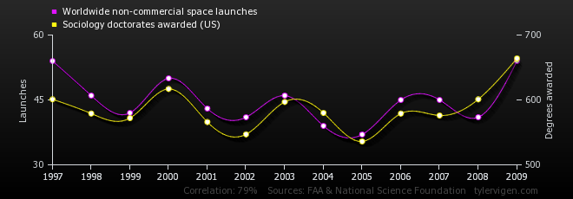
Spurious Correlations
http://www.tylervigen.com/spurious-correlations

Slide 35
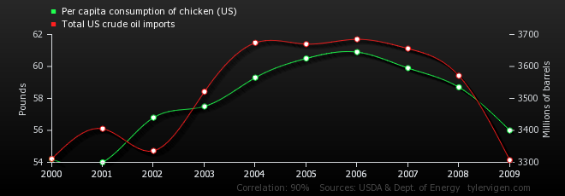
Spurious Correlations
http://www.tylervigen.com/spurious-correlations

Slide 36
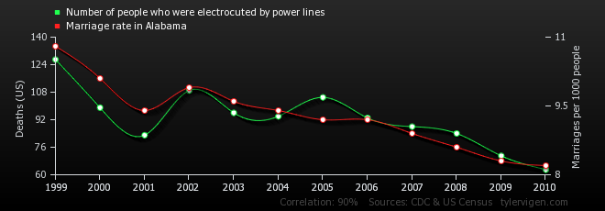
Spurious Correlations
http://www.tylervigen.com/spurious-correlations

Slide 37
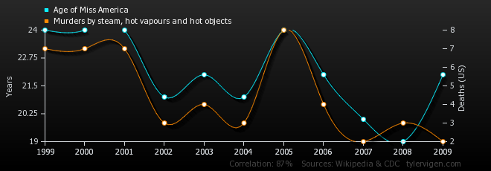
Spurious Correlations
http://www.tylervigen.com/spurious-correlations

Slide 38
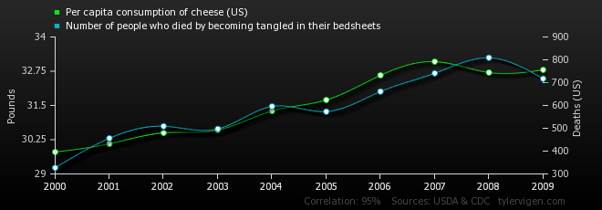
Spurious Correlations
http://www.tylervigen.com/spurious-correlations

Slide 39
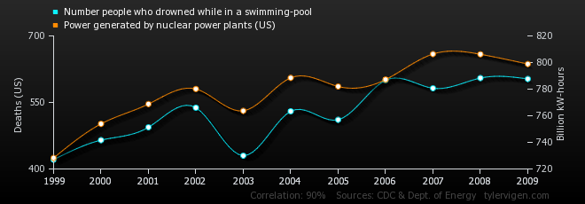
Spurious Correlations
http://www.tylervigen.com/spurious-correlations

Slide 40
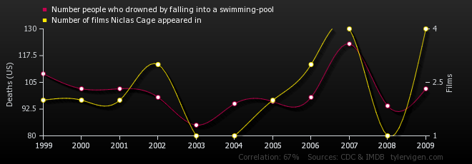
Spurious Correlations
http://www.tylervigen.com/spurious-correlations

Slide 41
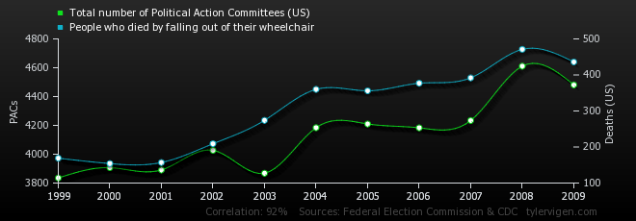
Spurious Correlations
http://www.tylervigen.com/spurious-correlations

Slide 42
Spurious Correlations
http://www.tylervigen.com/spurious-correlations

Slide 43
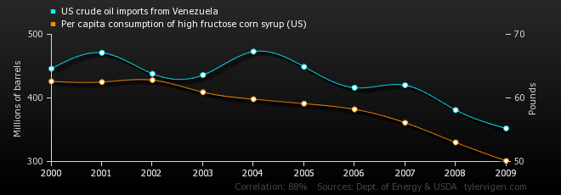
Spurious Correlations
http://www.tylervigen.com/spurious-correlations

Slide 44
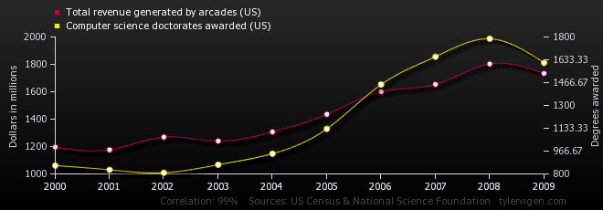
Spurious Correlations
http://www.tylervigen.com/spurious-correlations

Slide 45
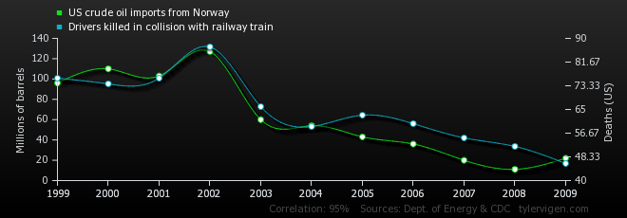
Spurious Correlations
http://www.tylervigen.com/spurious-correlations

Slide 46
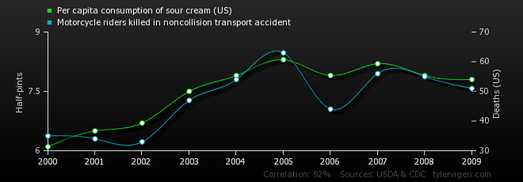
Spurious Correlations
http://www.tylervigen.com/spurious-correlations

Slide 47
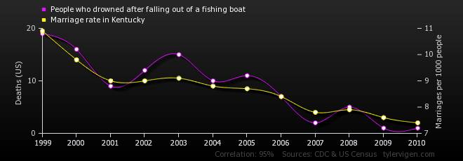
Spurious Correlations
http://www.tylervigen.com/spurious-correlations

Slide 48
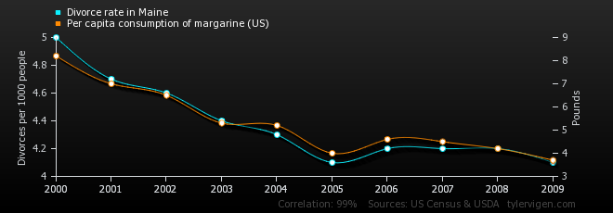
Spurious Correlations
http://www.tylervigen.com/spurious-correlations

Slide 49
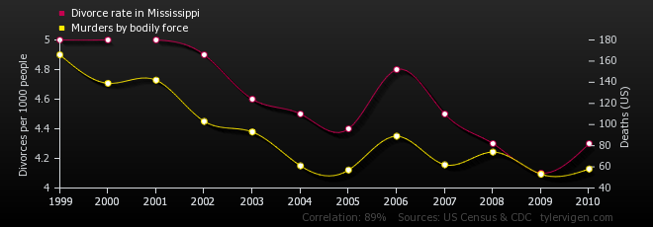
Spurious Correlations
http://www.tylervigen.com/spurious-correlations

Slide 50
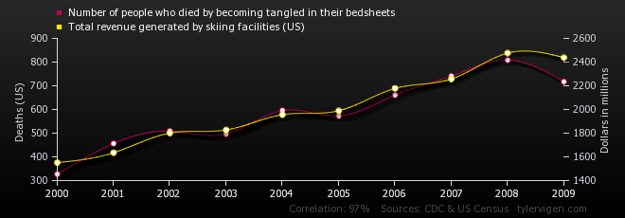
Spurious Correlations
http://www.tylervigen.com/spurious-correlations

